Slide 1
Cryptanalysis
Objective to recover key not just message
General approaches:
  cryptanalytic attack
  brute-force attack

Slide 2
Cryptanalysis Attacks
Crypt Analysis Attack
Cipher Text Only
Known Plain Text
Chosen Plain Text
Chosen Cipher Text

Slide 3
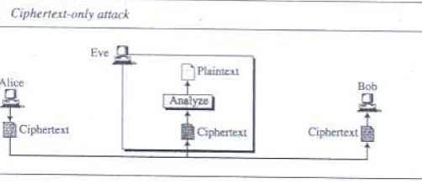
Cipher Text Only Attack

Slide 4
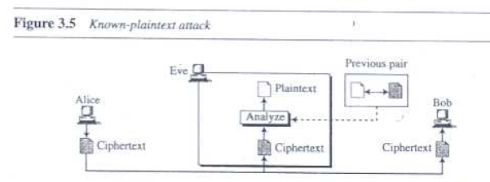
Known Plain text Attack

Slide 5
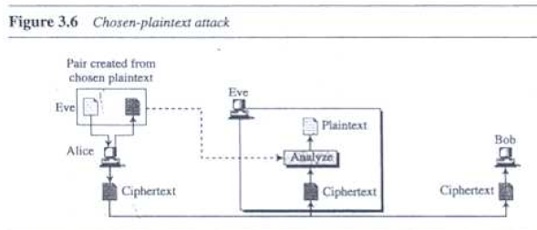
Chosen Plain text Attack

Slide 6
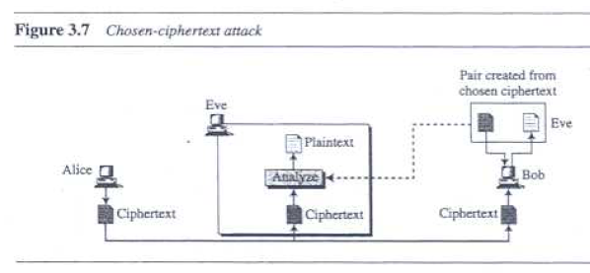
Chosen Ciphertext Attack

Slide 7
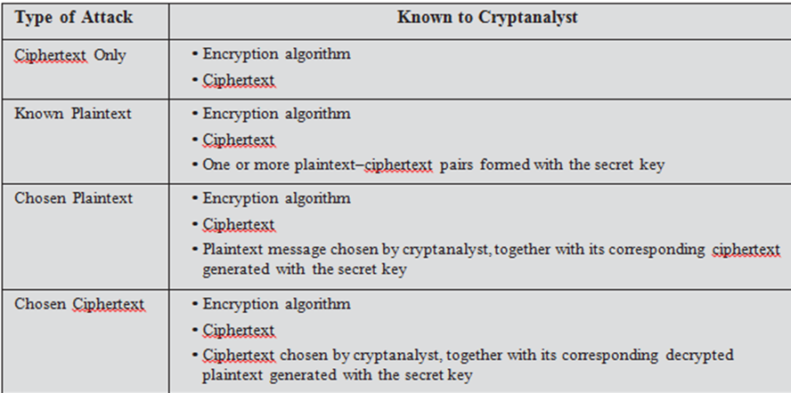
Cryptanalytic Attacks

Slide 8
Brute Force Attack
Try every possible key
Key Size (bits) | Number of Alternative Keys | Time required at 1 decryption/µs | Time required at 10⁶ decryptions/µs
32 | 2³² = 4.3 × 10⁹ | 2³¹ µs = 35.8 minutes | 2.15 milliseconds
56 | 2⁵⁶ = 7.2 × 10¹⁶ | 2⁵⁵ µs = 1142 years | 10.01 hours
128 | 2¹²⁸ = 3.4 × 10³⁸ | 2¹²⁷ µs = 5.4 × 10²⁴ years | 5.4 × 10¹⁸ years
168 | 2¹⁶⁸ = 3.7 × 10⁵⁰ | 2¹⁶⁷ µs = 5.9 × 10³⁶ years | 5.9 × 10³⁰ years
26 characters (permutation) | 26! = 4 × 10²⁶ | 2 × 10²⁶ µs = 6.4 × 10¹² years | 6.4 × 10⁶ years

Slide 9
Statistical Attack
Cryptanalyst can benefit from some inherent characteristics of the plain text language to launch a statistical attack.
For Eg: we Know that letter E is the most frequently used letter in english text. Cryptanalyst finds the most used character in the cipher text and assumes the corresponding plain text as E.

Slide 10
Pattern Attack
Some Ciphers may hide the characteristics of Language, but may create some patterns in the cipher text.
Cryptanalyst may use a pattern attack to break the cipher.

